Slide 1

Software engineering careers
Steve Chenoweth
Computer Science & Software Engineering, RHIT
This file is out on your Moodle web page
Notes:
The idea of a career goes beyond just “starting salary.” Instead, we ask, what’s the whole picture?
Will the people shown in the picture have a rewarding life, with rich, challenging work?
You also can ask, “How much will they make?” And, in fact, in software they do make good money. We show that on some of these slides. However, it doesn’t really take a lot to make people “happy.” Economists Daniel Kahneman and Angus Deaton showed that in a 2015 study. If you make what many engineers in the US make – all kinds of engineers – you are over the threshold where this makes a big difference. (See http://time.com/money/4070041/angus-deaton-nobel-winner-money-happiness/).
So, we’ll also talk about other values that are important, which might make software engineering an interesting and enriching career.
In this discussion, majoring in both Computer Science, and also in Software Engineering itself, can be seen as paths toward this career. In a few spots we clarify some of the differences in these majors.
Image from https://www.glassdoor.com/employers/blog/4-tips-for-hiring-the-elusive-software-engineer-infographic/

Slide 2
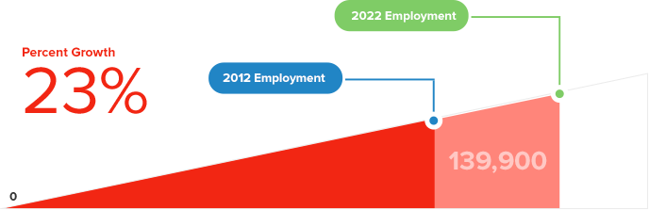
Will there be jobs?
Revised
The US Bureau of Labor Statistics now has the job growth for 2016-2026 as 30.7% (255,000 jobs)
Notes:
It is important to know if you are likely to have job opportunities to consider, over your career.
This is hard to predict, for any kind of work. However, much of the general threat comes from automation itself. And software people are the ones who automate many things we do – we sell software systems which simplify and speed-up tasks for humans. So, in a way, perhaps we should feel guilty for doing this, though it certainly falls within the bounds of how an efficient economy is supposed to operate. And, at the same time, we may be the least likely group to lose our own jobs, because businesses understand the advantages of the efficiencies we provide.
There really is a serious long-term shortage of software people in the US and elsewhere. The supply of qualified people generated by universities, or homegrown through experience, or created by moving people from other areas into software, simply isn’t enough to meet the demand for people building software in the US. This supply problem surely is exacerbated by new government policies intended to cut all kinds of immigration. The result is that the growth is slowed, of profitable software that could be developed here.
The problem also is made worse by our historic inability to attract women and minorities into this field, in the US. That inequity also maintains the concern that software-based products and services mismatch the needs of users, because they are developed by a different group of people. This is true for example in social media, where over half the audience is women, but only a small percentage of the developers are women.

Slide 3
STEM career comparisons
Notes:
Total projected 2016-2026 growth in the 4 software-based jobs in the US, shown at top: 362.3 K.
Total projected 2016-2026 growth in the all the rest of the STEM-based jobs in the US: 95.4 K.
Source: https://data.bls.gov/projections/occupationProj

Slide 4
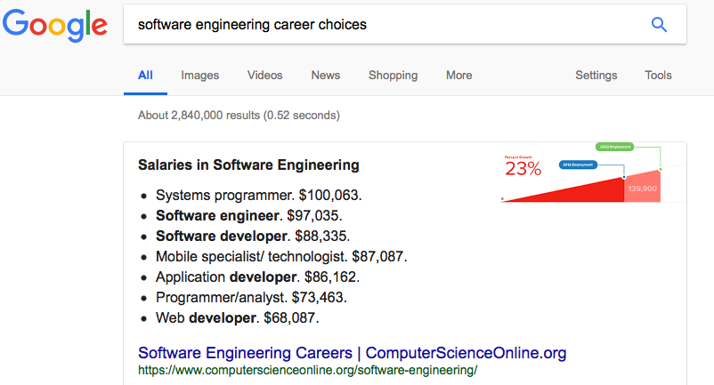
What will you do?
Notes:
Consider the top job areas, within software engineering, that Google lists here.
The variety of software work is the most important thing to see here, though Google lists the hiring salaries, as well.
Systems programmers, for example, write software that is used by other programmers. While most of these other groups write software for people who are not programmers. See Slide 7 for more details about the kinds of work.

Slide 5

Typical activities
Talk to customers about what they want
Design systems
Write and test code – on teams
Test the whole system
Deliver it to customers
Lead other developers
Improve how software is developed
“This is exactly what I wanted…”
Notes:
Contrary to popular opinion, software engineers do not just write code. They do all these other activities, as equally valuable parts of the work.
Talking to customers, like you see pictured here, is crucial. If you get it wrong, as to what a major customer wants, you can imagine it doesn’t work out as well as the caption I gave to the picture. Gathering and managing customer requirements is an expert part of software work.
The last bullet is key – software engineers help set their own destiny, by deciding how they will go about it. This is part science and part engineering – things like developing best practices. The fact we play a role in deciding the processes we use is a part of being Agile – something discussed in the next slide.
Image from https://dissolve.com/video/Friendly-bank-workers-talking-customers-offering-financial-royalty-free-stock-video-footage/001-D84-120-050

Slide 6

Growing trend -- The teams are “Agile”
What’s that mean?
Individuals and interactions over processes and tools
Working software over comprehensive documentation
Customer collaboration over contract negotiation
Responding to change over following a plan
In other words – “empowered” teams vs “managed” teams
Right – An Agile team decides how they are doing, using PostIt notes.
Notes:
The fact that software engineers are in high demand has led to our having a lot of leverage in the workplace. In many or even most US software development organizations, the “team” of developers has a lot of power to decide the right way to do things, and whether or not they are doing a good job, and the specific processes they need to be using to be successful.
This same “empowerment” of teams does not exist in all engineering organizations, though it seems to be shifting in this direction, based on the successes of “Agile” in software development. In some areas of engineering, Agile is similar to to the idea of Lean product development, which also is growing in popularity.
You can see that a goal of Agile, in the meaning described above, is to cut out unnecessary steps in getting the job done. Agile also tries to avoid problems which have plagued software development in the past, like having a fixed contract with customers, every bit of which must be satisfied in a predetermined timeframe.
All these changes help make the life of the software engineer much better!
Image from https://www.b2ttraining.com/product/agile-team-overview/

Slide 7
Is it rewarding?
In 2014, U.S. News & World Report listed software developer as the best job in the country
and Career Cast ranked it as the 7th best career field.
From https://www.computerscienceonline.org/software-engineering/
Notes:
The fast pace and competitiveness of software engineering don’t exactly make it a “dream job” in the sense of being easy. But, for a hard job, it’s very nice.
Using Agile development processes, just mentioned, plays a big role in making software engineering a satisfying thing to do. We interact directly with the parties who make a difference, like our customers, and we control how we go about doing our work.
Maybe other types of engineering will move equally far in this direction? Right now, the fact we largely set our own destinies, versus mostly waiting to hear what to do from the people one works for, is is an advantage for picking a software engineering career. You feel especially valued as a technical contributor, as your company rolls out software-based products and services.

Slide 8
Typical work
APPLICATIONS DEVELOPMENT
Problem solving-based, non-Web-based software development that includes programming languages such as Java and C#.
SYSTEMS DEVELOPMENT
Designing and coding background software created to support application development; includes program languages like C and C++.
WEB DEVELOPMENT
Designing software or applications to run in a Web browser and used programming languages such as HTML, JavaScript and PHP.
EMBEDDED SYSTEMS DEVELOPMENT
Designing computing systems and software to work on non-computing devices, such as automobiles. Uses programming languages such as C and assembly languages. (But see note, below here.)
Notes:
Here’s where we sketch some of the different styles of work that a software engineer may do. All of these involve the activities described on Slide 4.
Applications Development also includes a strong aspect of Interaction Design – creating User Experiences. Skills at doing this are increasingly valued in this field.
Systems Development is a place where a degree in Computer Science can be a good choice because the application of underlying scientific principles can make a big difference in how fast or how reliably this software works, and the software created impacts a lot of software built on top of it.
In Web Development, there often is much more to it – not emphasized here is developing the server side of the web software, something that is a big part of the job and very interesting to do. Consider, for example, developing web services in the Cloud to meet the needs of large numbers of users.
For Embedded Systems Development, an understanding of Computer Engineering can be very helpful, because a lot of the software closely interacts with hardware. The comment at the end of this description refers to the changing nature of such software. Much of it now is done in higher-level languages and more resembles Applications Development. This is because of the growing amount of software that looks like applications and serves users in new ways, that we see on automobiles and appliances.

Slide 9
Typical career paths
Typical starting job
Later options
Possible fan-outs / end states
Director of Engineering
Entrepreneur / CEO
Human interface specialist
Data engineer
Network engineer
Technical writer
Chief Information Officer
Product lines architect
Software product sales
Software
designer
Software or
systems
architect
Project manager
Resource manager
Systems analyst
Product manager
Software product developer
(on many kinds of systems)
Software QA (testing)
Building software for
multi-disciplinary systems
Software IT developer
Sample career path
shown with arrows
Notes:
“Later” in this picture could be any time – about a third of Rose alumni progress to some position where they have significant leadership, within 5 years. That includes jobs like shown under “Later”.
IT is “Information Technology”. Typically this refers to systems built for internal use by an organization. Like the payroll system for a company. In technically-focused companies, IT can include complex systems – like the production system for a pharmaceutical company.
A Systems Analyst or Business Analyst talks to customers about their requirements.
A Resource Manager is in charge of the people working on projects. They often have multiple projects, if these are small. They do hiring, manage budgets, etc.

Slide 10
Trends
Mobile has become a $3.3 trillion dollar industry
Security is projected to be a $60 billion dollar industry in 2015
Big Data is just starting to scratch the surface as a $125 billion dollar industry
Internet of Things is projected to become a $7.1 trillion dollar industry by 2020
Robotics is a $12.3 billion dollar industry
Cloud computing is a $100 billion dollar industry
Health informatics is a $6 – $7 billion dollar industry
Notes:
This is another way of saying that there will be high demand for software engineers for a long period of time.
Note that some of these numbers are Trillions, not Billions.
You can imagine how competitive most of these areas are – Like, anyone in the world can write an app for an iPhone and sell it from Apple’s online store for 99 cents. So, the fortunes of companies large and small tend to vary a lot over time. One year Apple or Amazon is in trouble, the next it is among the most profitable in the world.
Just picking a particular area from this list could be a career – like digesting all the data produced by some category in the Internet of Things.

Slide 11

Cool places to work
TWITTER
Social Media $121,642
LINKEDIN
Social Networking $127,557
FACEBOOK
Social Networking $118,445
GUIDEWIRE
Life and Property Insurance Software $108,918
GOOGLE
Search Engine $118,968
QUALCOM
Semiconductor Manufacturing $88,312
RIVERBED
Enterprise Network Hardware/Software $109,464
INTUIT
Financial and Tax Preparation Software $137,424
MATHWORKS
Computational Software for Engineering $81,060
RED HAT
Open Source Software $79,725
NETAPP
Enterprise Computer-Storage Products $93,726
RACKSPACE
Cloud Computing and Web-Hosting $82,000
INTEL
Semiconductor Manufacturing $97,403
APPLE
Consumer Technology Devices $110,867
CAREERBUILDER.COM
Job Recruitment Website $73,850
CITRIX
Enterprise Software $88,728
TEXAS INSTRUMENTS
Semiconductor Manufacturing $91,633
EBAY
E-Commerce $120,424
SALESFORCE
Cloud Computing $112,942
NATIONAL INSTRUMENTS
Test Equipment for Building Technology $64,129
New SalesForce “Obelisk”
In San Francisco
Notes:
These are some leading employers of software people. There are many more, including branches of the US government, for instance.
The salaries noted are average hiring salaries for people who do software work there.
The fact these are so high is largely influenced by the shortage – the demand for qualified people significantly exceeds the supply. This also affects working conditions and the ability of software engineers to help control their own destinies on the job – see Slide 5 on Agile.
Image from https://www.archdaily.com/889519/salesforce-tower-pelli-clarke-pelli-architects

Slide 12
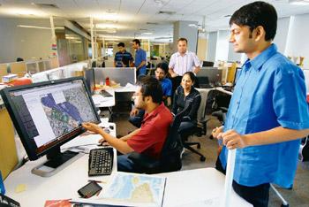
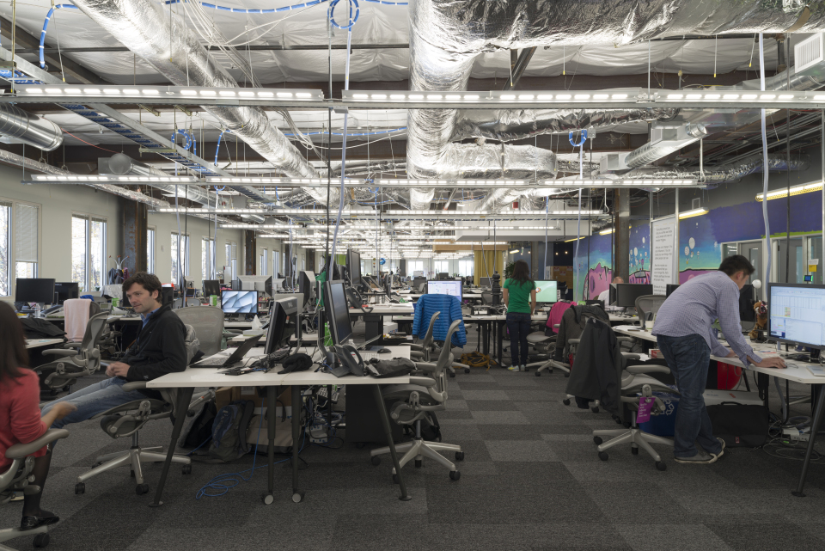
What’s it like?
Social, not solo all the time
Intense and competitive
More turnover than some “stable” jobs
Creative – you get to see your stuff work
Good vibes – you benefit users
Cross-disciplinary – a part of everything
Long hours? It depends…
Right – software engineers working at Google in India, and at Facebook’s headquarters.
Notes:
The list of “what it’s like” qualities are intended to frame your expectations of this kind of work. While the Facebook people shown all seem to be off programming on their own, this is just a part of what they do. One reason they are in “open” offices is to promote interaction. That is key to their success on a software project.
The “Long hours” point at the end has to do with the variability of this aspect. In adopting Agile practices, some teams are able to bargain for a very reasonable work week, arguing that this makes them more focused while they are on the job. At some large companies, software workers are encouraged to just work a normal schedule. However, in other businesses, overtime is in fact a way of life. Especially notorious for this is the software game development industry, who have a reputation for squeezing as much work out of each developer as they can. So, this aspect of working conditions varies a lot – you need to find a way to discover what it’s like at a particular place of work, before signing up there.
Facebook image from https://newsroom.fb.com/media-gallery/menlo-park-headquarters/inside-facebook-headquarters/
Google India image from https://www.livemint.com/Industry/DAMO9oEbyMfTqgOhsz9ofJ/Putting-India-on-the-map.html

Slide 13
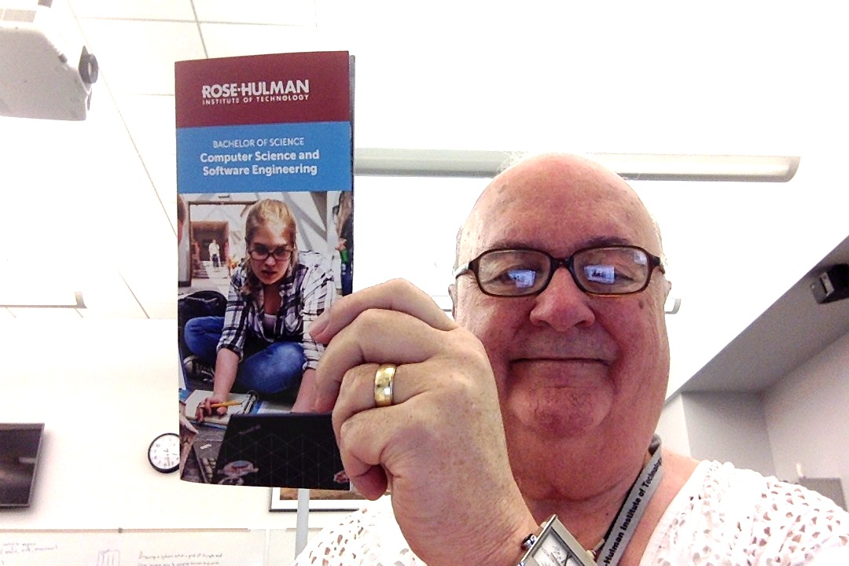
Rose-Hulman’s CS and SE programs
See the brochure we handed out!
Experiential learning emulates industry.
Faculty support based on our experience.
Students support each other’s studies.
Project and team-based courses.
Choice of CS, SE, or both majors.
International components, including getting an international CS degree.
Data science second major and Robotics minor options.
Opportunities for great internships as you study here.
Above – I “uphold” our programs!
Notes:
The opportunity to try doing this work is the most important background you can get.
Just hearing theory doesn’t do much to improve your skills – Doing it does.
Doing it in a supportive environment is golden.

Slide 14
Rose’s department is “CSSE”
What you’ll do in your career as a software engineer:
We offer both CS and SE majors:
CS has extra courses in theory of computing.
SE has extra courses in building industry-quality systems.
Both majors have theory as well as practice.
E.g., both include a Senior Project.
CS majors can opt to do a Thesis instead.
Rose is only 1 of 29 schools in the US to have an ABET-accredited SE program.
Mostly the “practice”
Notes:
CS = Computer Science
SE = Software Engineering
ABET: See http://main.abet.org/aps/Accreditedprogramsearch.aspx.
Why are there so few programs in Software Engineering, when this is the name of the vocation that CS majors also will work in?
We think it’s the theoretical bias of most colleges in the US. They typically started out as part of a Math department. Some began as a part of Electrical and Computer Engineering.
The PhD’s who populate CS departments are trained more in theory, in graduate school. So, why wouldn’t they think this is more important for their undergraduate students?

Slide 15

A modest proposal
If you are sure you want to do something else,
Go get a degree in that AND CS or SE. Or,
Get a minor in CS or SE.
A huge percentage of people with other majors end up working with software because
Software is a big part of their field, and
Creating software is where the jobs are.
Say, you love working for non-profits. They need software, badly. How’s that going to happen? How about you?
Notes:
Above picture – Mixing software development with political science and working for non-profit organizations. From https://andela.com/insights/doing-work-that-matters-rehema-wachiras-developer-journey/.

Slide 16

Or, Maybe you want to be an ME?
VP from Ford who is on one of our department advisory committees, in 2014:
“By 2016, every Ford will need to have 200 million lines of code running in it. I don’t know how we are going to get there.”
The 2016 Ford Fusion Hybrid – a pretty complex machine. Or, is it a computer with a machine?
Notes:
The person writing all this software for a mechanical device like a car has to know about both the car and the software. You can’t have teams of people who just know one or the other, and expect to be successful.
Ford used software to gain advantages over competitors – for example, having a V6 engine in their trucks, which was lighter and more powerful and got better mileage than other companies’ V8 engines.
Image from https://www.cars.com/research/ford-fusion_hybrid-2016/.

